Slide 1
AI-Driven mental health intervention platform
Business Case

Slide 2
The problem
Mental health education campaigns are designed for broad audiences
They do not account for individual attitudes, stigma levels, or demographics
No data-driven method to prioritize who should receive which intervention

Slide 3
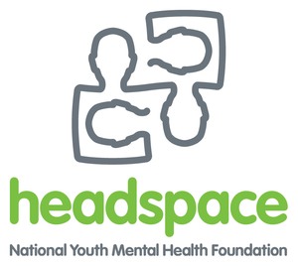

Target markets
Mental Health Clinics
Schools
Universities
Hospitals
Research Centres

Slide 4
The solution
An AI platform that predicts young people’s attitudes toward the helpfulness of anti-psychotic medications

Slide 5
Key outcomes
89% prediction accuracy
Enables targeted, evidence-based mental health education
Reduces stigma toward medication treatment pathways

Slide 6
How it creates value
Mental health education campaigns focus on people who need persuasion
Skepticism of anti-psychotic medication is identified before prescription
Messaging can be tailored to underlying concerns

Slide 7
89.3% reduction in wasted outreach spend
87.5% return on education investment
Enables tiered intervention strategies
(high, medium, low support)

Slide 8
Unique value proposition
Predict attitudes towards medication without asking direct, sensitive questions
Identify skepticism before medication is prescribed
Explain why someone is sceptical using feature importance
Uses high-quality psychological data
Combines mental health expertise with machine learning

Slide 9
Target the right people, with the right message, at the right time
Smarter Mental Health Education Starts With Data

